Slide 1

Analysis of Effective Watermarking Techniques in Images
Meesum Khan, Abichal Ghosh, Zuy Pham, Nikhil Bindem

Slide 2

Problem Statement
85% of images shared online daily are unlicensed ⁵
Photographers and agencies lose an average of $446 per stolen image ⁵
Are watermarks a possible solution?
68% of watermarked images have their watermarks removed since the watermarks are often not strong enough ⁵
Which watermark styles are most effective against detection and removal?

Slide 3

Related Works
Convolutional Neural Networks
Two-step method ²
Locate the watermark in the given image
Convert watermarked pixels back to their original form
Adversarial Learning
Patch-based discriminator ⁹
Use the reconstructed image and original image to improve the reconstruction
REFIT ¹
Use fine-tuning and two different methods (EWC algorithm and unlabeled data augmentation) to remove watermarks without affecting the model's functionality under a weak threat model

Slide 4
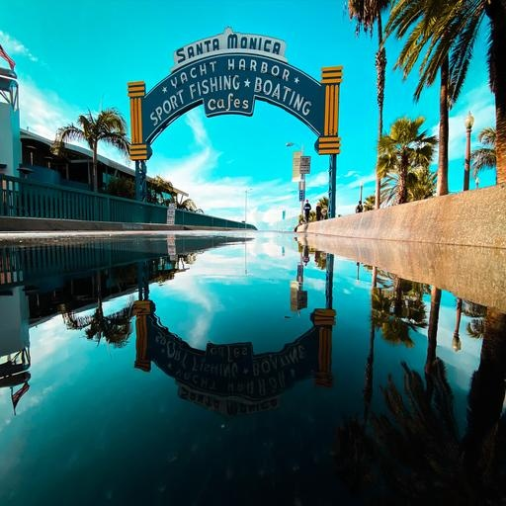
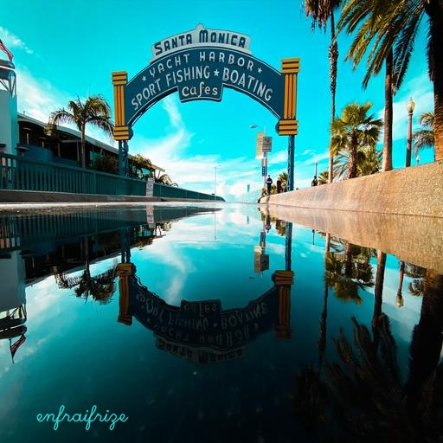
Data
Scenery Watermark Detection dataset ⁴
12779 images not watermarked
Embedded watermarks ourselves
Generated random English words, random color, random thickness and font, random opacity level, random location
Each image is 512 x 512 pixels and RGB-colored, thus yielding 786432 features
For testing, we created 6 different types of watermarks
cursive, rotated, not rotated, small text, low image opacity, low text opacity.

Slide 5


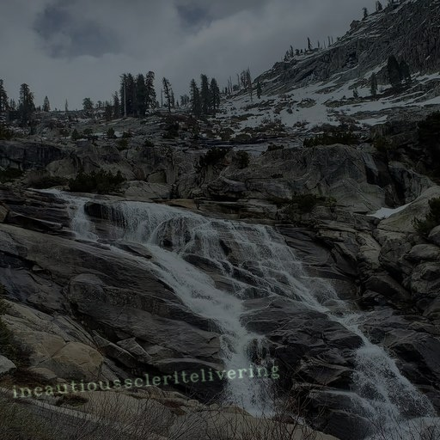
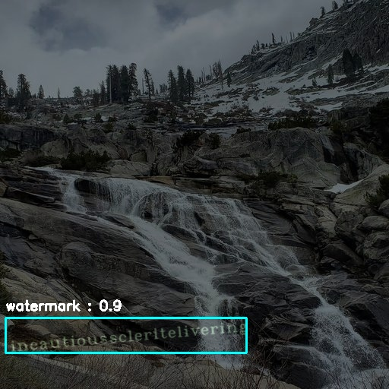
Methods - Watermark Detection
UNET
Masks created for all watermarks
0 (black) = no watermark
1 (white) = watermark
YOLO v8
Chosen method
Pass through the image once
Divide it into blocks
Give a prediction score based on
how likely there is an object in
that block
original watermarked image
masked watermark
original watermarked image
bounded-box watermark

Slide 6
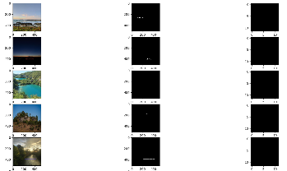
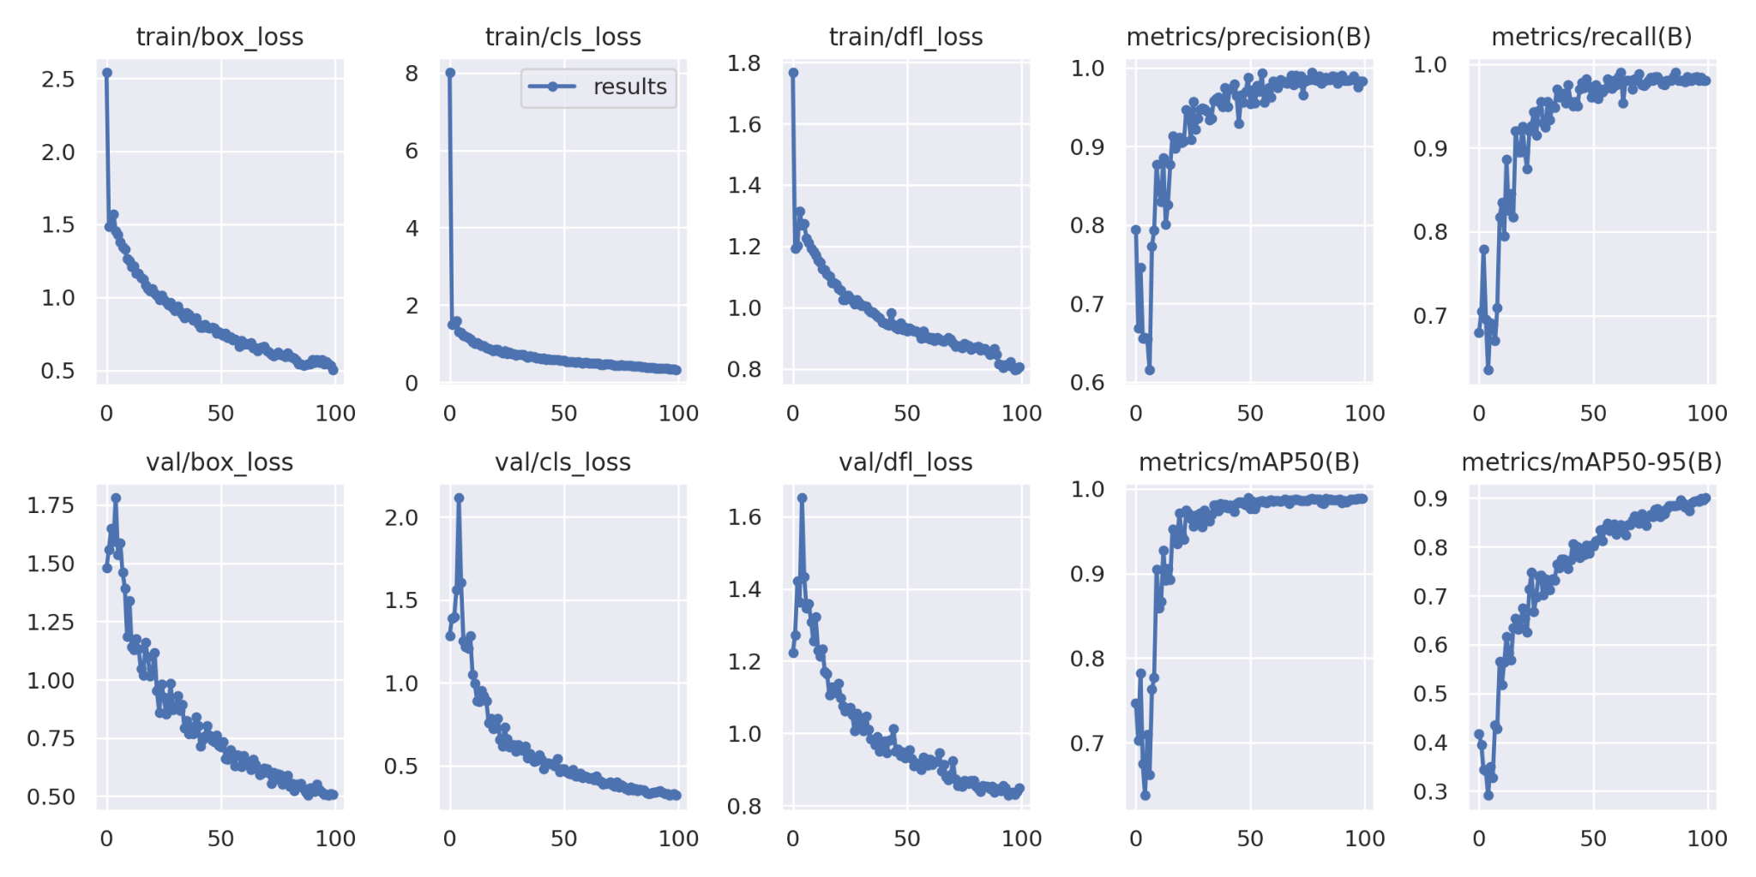
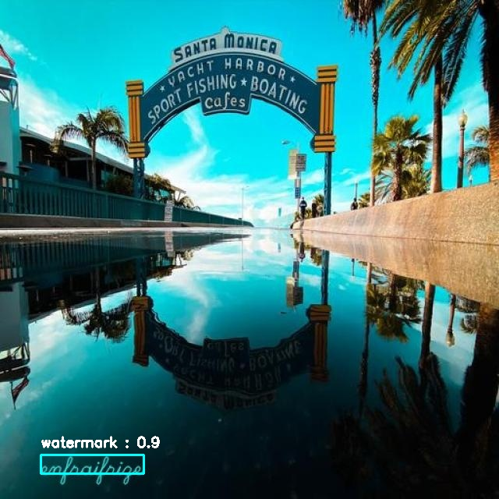
Results - Watermark Detection
UNet performed poorly
Mostly black → loss function low
YOLO v8 performed well
High accuracy on watermark bounding boxes
UNet Predictions: Leftmost column: Watermarked images, Middle column: Watermark masks, Rightmost column: Predictions
YOLO V8 Training Metrics Graph
Test Image with Predicted Watermark

Slide 7
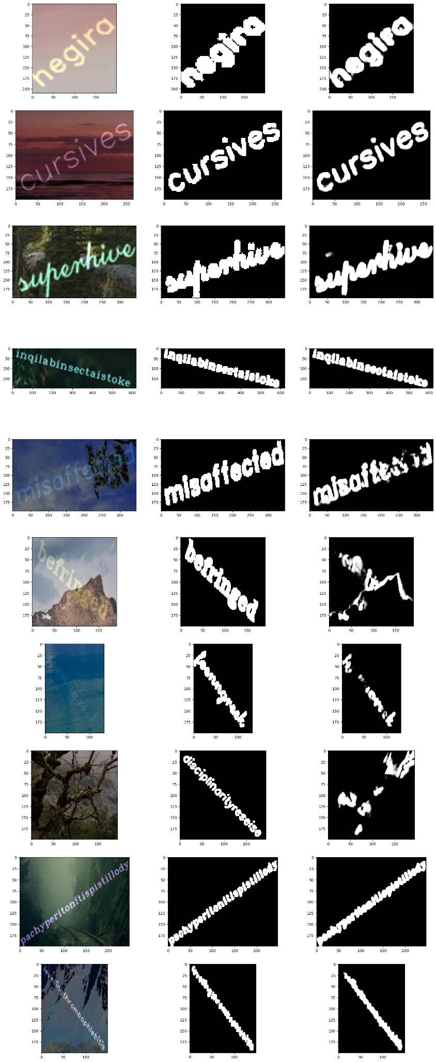
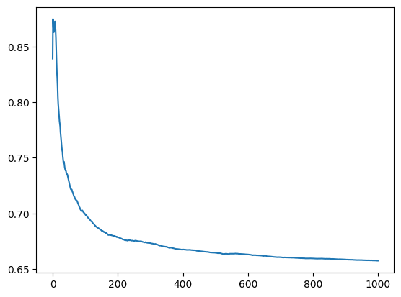
Results - Watermark Detection Mask Detection
U2Net detection for masks above bounding boxes predicted by YOLO
Predicted watermark Masks
U2Net Training

Slide 8
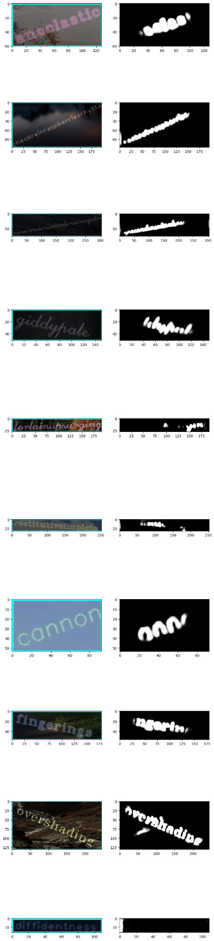
Results - Watermark Detection Mask Detection
U2Net detection

Slide 9
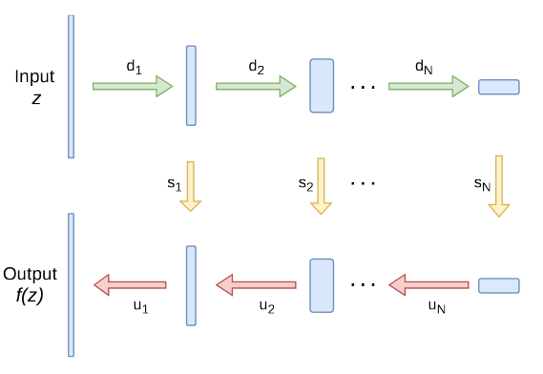
Methods - Watermark Removal
Generative Adversarial Networks
Chosen method
Hourglass (encoder-decoder) architecture
Forget the black pixels, relearn (predict the pixel values)
the marked pixels in the decoder part
Autoencoder
Convolutions and ReLU in the encoder(4 layers deep)
Deconvolutions and ReLU in the decoder(4 layers deep)

Slide 10
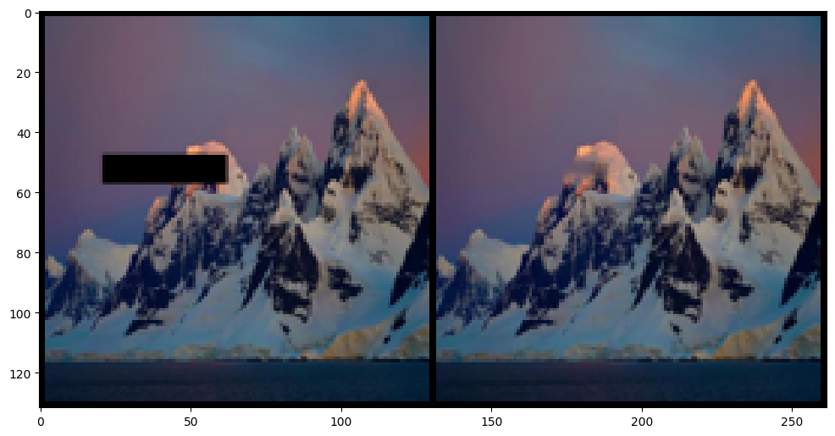
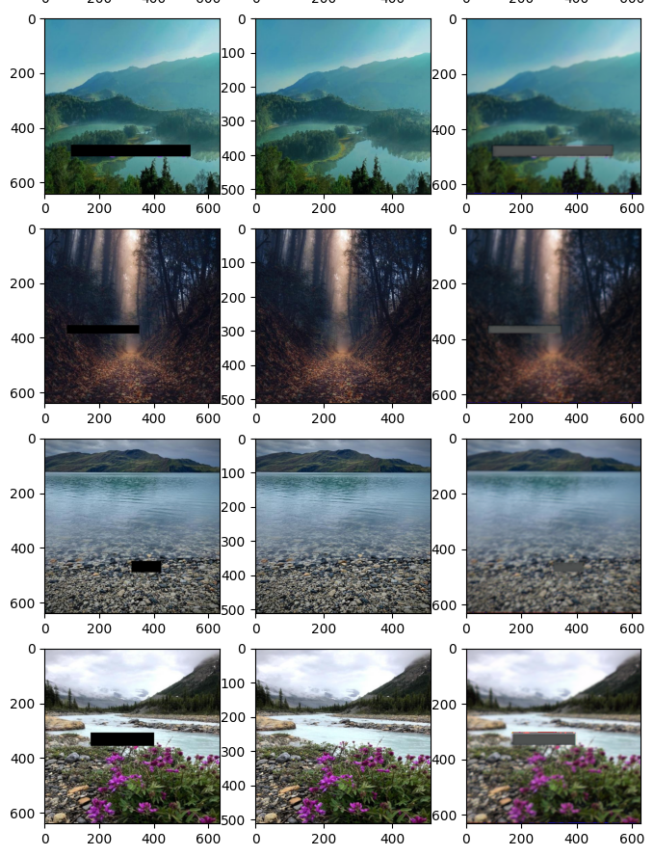
Results - Watermark Removal
GANs performed considerably well
Cannot remove the watermarks completely if some parts
of the watermarks are not enclosed within the boxes
detected by YOLO v8
Since the image is covered by a box rather than outline,
it leads to some incorrect reconstructions
Autoencoder
Unable to perform as well as GAN
Mostly due to the smaller depth pg the layers
Doesn’t utilize as much computational power
GAN Prediction: Left: masked image, Right: reconstructed image, part of the mountain covered by mask gets incorrectly reconstructed as sky

Slide 11

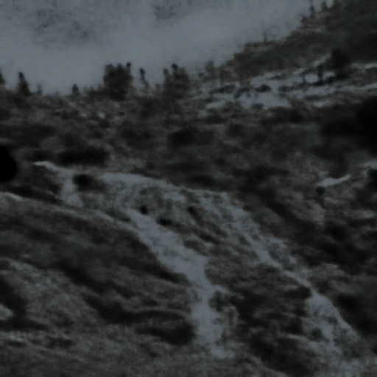
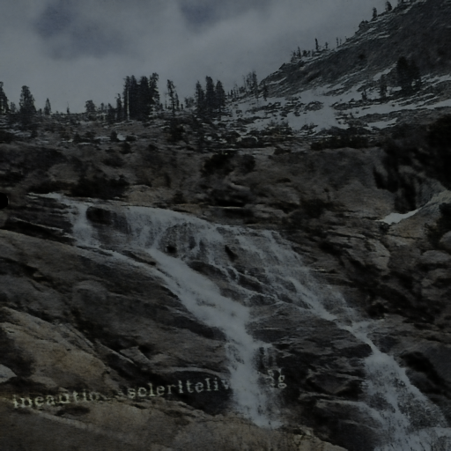
Results - GANs Watermark Removal
Image Low Opacity
SSIM SCORE: 0.43

Slide 12
Tabulated Results
DATASET | SSIM
Cursive | 0.68
Rotated | 0.72
No Rotation | 0.39
Low Opacity Image | 0.43
Small Text | 0.55

Slide 13
Results - Watermark Removal
GANs performed considerably well
Cannot remove the watermarks completely if some parts
of the watermarks are not enclosed within the boxes
detected by YOLO v8
Since the image is covered by a box rather than outline,
it leads to some incorrect reconstructions
Autoencoder
Unable to perform as well as GAN
Mostly due to the smaller depth pg the layers
Doesn’t utilize as much computational power
GAN Prediction: Left: masked image, Right: reconstructed image, part of the mountain covered by mask gets incorrectly reconstructed as sky

Slide 14
Results - Watermark Removal
GANs performed considerably well
Cannot remove the watermarks completely if some parts
of the watermarks are not enclosed within the boxes
detected by YOLO v8
Since the image is covered by a box rather than outline,
it leads to some incorrect reconstructions
Autoencoder
Unable to perform as well as GAN
Mostly due to the smaller depth pg the layers
Doesn’t utilize as much computational power
GAN Prediction: Left: masked image, Right: reconstructed image, part of the mountain covered by mask gets incorrectly reconstructed as sky

Slide 15
Conclusion
YOLO v8 is best for watermark detection
U2NET performs better than UNet
GANs is best for watermark removal
Future Work:
Add more variations for watermarks and experiment with more watermark features
implement stronger UNET model to segment watermark better
Improve on Autoencoder model

Slide 16
References
[1] Xinyun Chen, Wenxiao Wang, Chris Bender, Yiming Ding, Ruoxi Jia, Bo Li, and Dawn Song. 2021. REFIT: A Unified Watermark Removal Framework For Deep Learning Systems With Limited Data. In Proceedings of the 2021 ACM Asia Conference on Computer and Communications Security (Virtual Event, Hong Kong) (ASIA CCS ’21). Association for Computing Machinery, New York, NY, USA, 321–335. DOI:https://doi.org/10.1145/3433210.3453079.
[2] Danni Cheng, Xiang Li, Wei-Hong Li, Chan Lu, Fake Li, Hua Zhao, and Wei-Shi Zheng. 2018. Large-Scale Visible Watermark Detection and Removal with Deep Convolutional Networks. In Pattern Recognition and Computer Vision, Jian-Huang Lai, Cheng-Lin Liu, Xilin Chen, Jie Zhou, Tieniu Tan, Nanning Zheng, and Hongbin Zha (Eds.). Springer International Publishing, Cham, 27–40. DOI:https://doi.org/10.1007/978-3-030-03338-5_3
[3] Tali Dekel, Michael Rubinstein, Ce Liu, and William T. Freeman. 2017. On the Effectiveness of Visible Watermarks. In 2017 IEEE Conference on Computer Vision and Pattern Recognition (CVPR). 6864–6872. DOI:https://doi.org/10.1109/CVPR.2017.726.
[4] Vesnin Dmitry. 2023. Scenery Watermark Detection. https://doi.org/10.34740/KAGGLE/DSV/4926870
[5] Mary Eising. 2019. Global infringement report 2019 - Copytrack. (2019). Retrieved April 13, 2023 from https://www.copytrack.com/wp-content/uploads/2019/03/Global_Infringement_Report_2019_EN.pdf.
[6] Yongjian Hu, S. Kwong, and Jiwu Huang. 2005. An algorithm for removable visible watermarking. IEEE Transactions on Circuits and Systems for Video Technology 16, 1 (December 2005), 129–133. DOI:http://dx.doi.org/10.1109/tcsvt.2005.858742.
[7] Glenn Jocher, Ayush Chaurasia, Alex Stoken, Jirka Borovec, NanoCode012, et al. 2022, November 22. ultralytics/yolov5: v7.0 - YOLOv5 SOTA Realtime Instance Segmentation. Zenodo. https://doi.org/10.5281/zenodo.7347926.
[8] M.S. Kankanhalli, Rajmohan, and K.R. Ramakrishnan. 1999. Adaptive visible watermarking of images. In Proceedings IEEE International Conference on Multimedia Computing and Systems, Vol. 1. 568–573 vol.1. DOI:https://doi.org/10.1109/MMCS.1999.779263.
[9] Xiang Li, Chan Lu, Danni Cheng, Wei-Hong Li, Mei Cao, Bo Liu, Jiechao Ma, and Wei-Shi Zheng. 2019. Towards Photo-Realistic Visible Watermark Removal with Conditional Generative Adversarial Networks. In Image and Graphics, Yao Zhao, Nick Barnes, Baoquan Chen, Rüdiger Westermann, Xiangwei Kong, and Chunyu Lin (Eds.). Springer International Publishing, Cham, 345–356. DOI:https://doi.org/10.48550/arXiv.1905.12845.
[10] Jing Liang, Li Niu, Fengjun Guo, Teng Long, and Liqing Zhang. 2021. Visible Watermark Removal via Self-calibrated Localization and Background Refinement. CoRR abs/2108.03581 (2021). DOI:https://doi.org/10.48550/arXiv.2108.03581.
[11] Olaf Ronneberger, Philipp Fischer, and Thomas Brox. 2015. U-Net: Convolutional Networks for Biomedical Image Segmentation. CoRR abs/1505.04597 (2015). arXiv:1505.04597 http://arxiv.org/abs/1505.04597
[12] Hector Santoyo-Garcia, Eduardo Fragoso-Navarro, Rogelio Reyes-Reyes, Gabriel Sanchez-Perez, Mariko Nakano-Miyatake, and Hector Perez-Meana. 2017. An automatic visible watermark detection method using total variation. 2017 5th International Workshop on Biometrics and Forensics (IWBF) (April 2017), 1–5. DOI:http://dx.doi.org/10.1109/iwbf.2017.7935109.
[13] Dmitry Ulyanov, Andrea Vedaldi, and Victor S. Lempitsky. 2017. Deep Image Prior. CoRR abs/1711.10925 (2017). arXiv:1711.10925 http://arxiv.org/abs/1711.10925

